Slide 1
Physical Design of IoT By Mukund kulkarni

Slide 2
History of IoT
The first telemetry system was rolled out in Chicago way back in 1912. It is said to have used telephone lines to monitor data from power plants.
Telemetry expanded to weather monitoring in the 1930s, when a device known as a radiosonde became widely used to monitor weather conditions from balloons.
In 1957 the Soviet Union launched Sputnik, and with it the Space Race. This has been the entry of aerospace telemetry that created the basis of our global satellite communications today.

Slide 3
History of IoT
Broad adoption of M2M technology began in the 1980s with wired connections for SCADA (supervisory control and data acquisition) on the factory floor and in home and business security systems.
In the 1990s, M2M began moving toward wireless Technologies. ADEMCO built their own private radio network to address intrusion and smoke detection .
In 1995, Siemens introduced the first cellular module built for M2M.

Slide 4
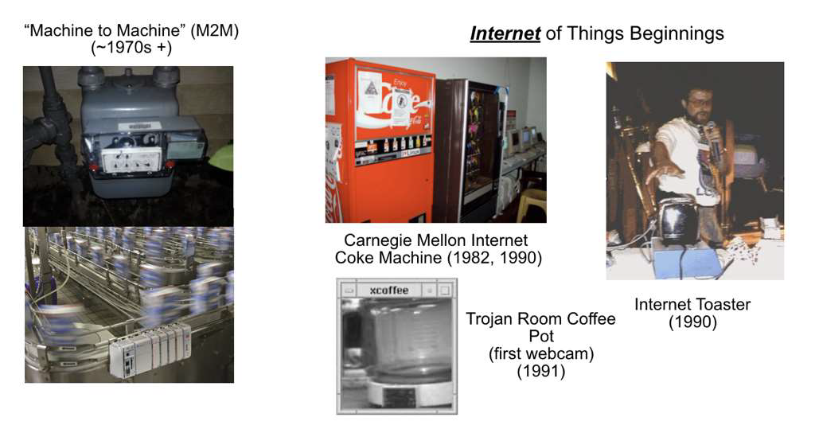
History of IoT

Slide 5
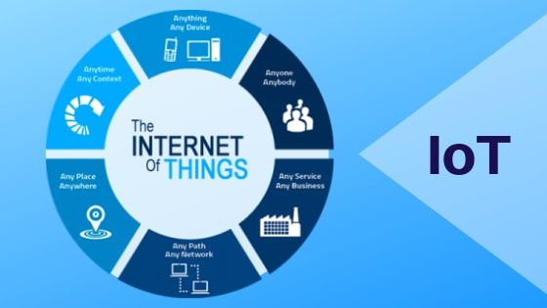
What is IoT - Definition
Internet connects all people,
so it is called “the Internet of People”
IoT connects all things,
so it is called “the Internet of Things”

Slide 6
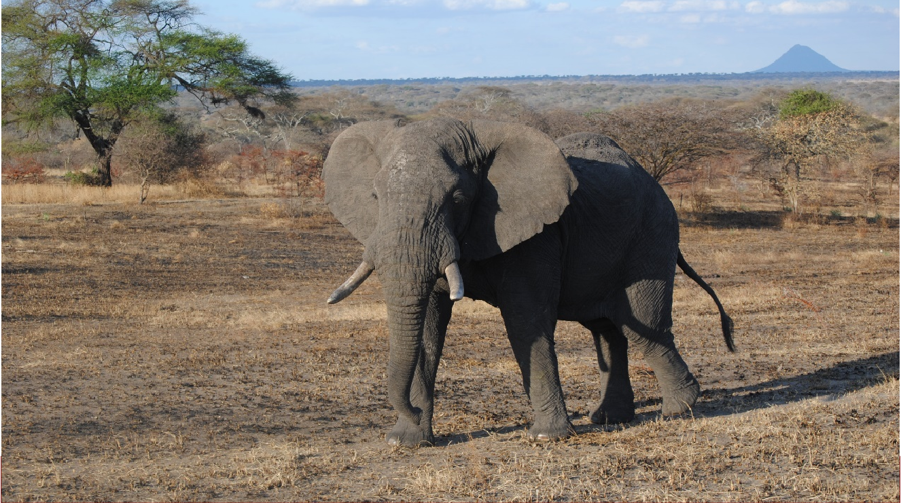
IoT – Definition
The Internet of Things, also called
The Internet of Objects, refers to a
wireless network between objects,
usually the network will be wireless
and self-configuring, such as
household appliances.
------Wikipedia
The IoT can be viewed as a global
infrastructure for the information
society, enabling advanced services
by interconnecting (physical and
virtual) things based on existing and evolving interoperable information
and communication technologies(ICT)
------ITU
What is IoT?
_{Cool} Locomotive for _{applications} innovation and
economic growth
Big data
Sensors
Internet
Security
Circuits
Sensors
Sensors
Reference : Bahga & Madisetti, © 2015 Book website: http://www.internet-of-things-book.com

Slide 7
Formal Definition of IoT
A dynamic global network infrastructure with self- configuring capabilities based on standard and interoperable communication protocols, where physical and virtual “things” have identities, physical attributes, and use intelligent interfaces, and are seamlessly integrated into information network that communicate data with users and environments.

Slide 8
Why Internet of Things?
Dynamic control of industry and daily life
Accessibility & Usability
Improve the resource utilization ratio
Universal transport & internetworking
Better relationship between human and nature
Flexible configuration
Forming an intellectual entity by integrating human society and physical systems

Slide 9
Characteristics of IoT
Dynamic Global network & Self-Adapting : Adapt the changes w.r.t changing contexts
Self Configuring : Eg. Fetching latest s/w updates without manual intervention.
Interoperable Communication Protocols : Communicate through various protocols
Unique Identity : Such as Unique IP Address or a URI
Integrated into Information Network : This allows to communicate and exchange data with other devices to perform certain analysis.
Notes:
Dynamic and self-Adapting:
IoT devices and systems may have the capability to dynamically adapt with the changing contexts and take actions based on their operating condition.Ex: Surveillance cameras can adapt their modes based on whether it is day or night.
Self – Configuring:
IoT devices may have self-Configuring capability allowing a large number of devices to work together to provide certain functionality .
Interoperable communication protocols:
IoT Devices may support a number of interoperable communication protocols and can communicate with other devices and also with the infrastructure.
Unique Identity:
Each IoT devices has a unique identity and a unique identifier.IPaddress, URI).IoT systems may have intelligent interfaces which adapt based on the context, allow communication with users and the environment contexts.
Integrated into information network:
IoT devices are usually integrated into the information network that allows them to communicate and exchange data with other devices and systems.

Slide 10
IoT - Advantages
Improved productivity of staff and reduced human labor. ...
Efficient operation management. ...
Better use of resources and assets. ...
Cost-effective operation. ...
Improved work safety. ...
Thorough marketing and business development. ...
Improved customer service and retention. ...
Better business opportunities.
Notes:
1. Improved productivity of staff and reduced human labor
Thanks to IoT solutions, mundane tasks can be done automatically, so human resources may be transferred to more complex tasks that require personal skills, especially out-of-the-box thinking. This way, the number of workers can be minimized, which results in reduced costs of business operation.
2. Efficient operation management
Another significant benefit offered by the interconnection of smart devices is automated control over multiple operation areas, including, among others, inventory management, shipping tracking, fuel and spare parts management. For example, this approach involves using RFID tags and a corresponding network of sensors to track the location of equipment and goods.
3. Better use of resources and assets
The automated scheduling and monitoring implemented with the help of interconnected sensors enable higher efficiency of resource use, such as improved power management and water consumption. For example, simple motion detectors may save significant sums of money in electricity and water bills, thus making both small and large businesses more productive and eco-friendly.
4. Cost-effective operation
Due to the reduced downtime periods, ensured by automatically scheduled and controlled maintenance, supply of raw materials, and other manufacturing requirements, the equipment may have a higher production rate resulting in bigger profits. Again, IoT devices greatly facilitate management within individual departments and across the whole enterprise structure.
5. Improved work safety
In addition to the abovementioned benefit, the scheduled maintenance is also highly advantageous for ensuring operational safety and compliance with the required regulations. In their turn, safe working conditions make the enterprise more attractive for investors, partners, and personnel, increasing the brand reputation and trust. Smart devices also reduce the probability of a human error during various stages of business operation, which also contributes to a higher level of safety. In addition, a network of IoT devices such as surveillance cameras, motion sensors, and other monitoring devices can be utilized to ensure the security of an enterprise and prevent thefts and even corporate espionage.
6. Thorough marketing and business development
Smart devices that are situated at homes, especially voice assistants and other appliances that can directly communicate with end-users on a regular basis, provide invaluable source information for business analysis. IoT helps enterprises by gathering large volumes of user-specific data employed for developing business strategies, targeted advertising, fine-tuning price policy, and other marketing and management activities.
7. Improved customer service and retention
The abovementioned collection of user-specific data achieved by using smart devices also helps businesses to understand the expectations and behavior of customers better. IoT also improves customer service by facilitating follow-ups after sales such as automatic tracking and reminding the customers about required maintenance of purchased equipment after its predefined period of use, the ending of warranty periods, etc.
8. Better business opportunities
Due to the increased effectiveness, the company that uses IoT solutions is able to offer a wider range of services or products, or increase their quality in comparison with its competitors, but at the same price. As an alternative, such a company may perform more challenging tasks in terms of production difficulty, time, or quantity. Altogether, the use of smart solutions makes an enterprise more competitive and attractive as a potential business partner.

Slide 11
IoT - Drawbacks
Security flaws
Associated costs
Power supply dependence
Network dependence
High skill requirements
Notes:
1. Security flaws
Insufficient security measures are the most widespread drawback that hinders the development of IoT as a whole. The fear of data leaks is always present because smart devices collect and transmit confidential information that can lead to drastic consequences if revealed. Yet, IoT solutions rarely contain adequate anti-tampering means or comply with all applicable data protection standards, encryption protocols, and other regulations and technologies designed to prevent unauthorized access to sensitive data. Failure to ensure sufficient data protection may lead to costly, disastrous, and even tragic consequences: identity thefts, loss of corporate secrets, equipment or products, sabotage, etc. That’s why the development and implementation of IoT solutions in business must be performed by professionals who can ensure that the installed hardware and software systems have no weak spots and are well-protected from any hacking attempts.
2. Associated costs
Implementation of IoT infrastructure in a business enterprise implies building an extensive network comprising multiple smart devices and the associated technical infrastructure, including the power supply grid and the communication network. That’s why such an initiative requires significant investments to install, maintain, and gradually expand the created network according to future needs. Though IoT solutions provide multiple benefits, it takes a lot of time before they become profitable, and their financial benefits exceed the initial costs of their implementation.
3. Power supply dependence
While IoT implies the autonomous operation of multiple devices, such a network remains highly dependent on external factors that must be considered in order to implement it successfully in business. First and foremost, smart devices are dependent on a stable and sufficient supply of electricity, so a well-planned additional infrastructure must be provided. It should include a suitable amount of UPS devices, surge protectors, and other equipment with relevant ingress protection (IP) ratings.
4. Network dependence
The core feature of the Internet of Things is the immense amount of interconnections between various devices and access to the global network. For this reason, IoT devices additionally require an infrastructure that ensures the uninterrupted wired and wireless communication with high throughput, low latency, and constant access to the Internet. So, to enjoy the benefits of IoS, a business enterprise first should provide the whole range of the required networking equipment: cables, routers, hubs, local data storage means, and so on.
5. High skill requirements
IoT solutions require responsible, experienced professionals who fully understand the scope and possible consequences of their work. Deploying, setting up, maintaining, and changing the scale of IoT solutions in a business enterprise demand highly skilled administrators who may be hard to find and recruit as they would expect respectively high salaries. All personnel who would have to deal with the implemented network of smart devices should receive proper training and sets of instructions. So, while IoT reduces the need for human resources, the remaining staff must be well-trained in order not to disrupt the operation of smart devices and not to cause the ”snowball effect.”

Slide 12
Layered Architecture – What and Why?
ticket (purchase)
baggage (check)
gates (load)
runway takeoff
airplane routing
ticket (complain)
baggage (claim)
gates (unload)
runway landing
airplane routing
Organization of air travel
airplane routing
a series of steps

Slide 13

Layered Architecture – What and Why?
Organization of air travel
ticket (purchase)
baggage (check)
gates (load)
runway (takeoff)
airplane routing
ticket (complain)
baggage (claim
gates (unload)
runway (land)
airplane routing
ticket
baggage
gate
takeoff/landing
airplane routing
airplane routing
airplane routing
departure
airport
intermediate air-traffic
control centers
arrival
airport
Layers: each layer implements a service
via its own internal-layer actions
relying on services provided by layer below

Slide 14
Why Layers?
Dealing with complex systems:
explicit structure allows identification, relationship of complex system’s pieces
layered reference model for discussion
modularization eases maintenance, updating of system
change of implementation of layer’s service transparent to rest of system
e.g. change in gate procedure doesn’t affect rest of system

Slide 15
Layered Models
ISO OSI Reference Model
application: supporting network applications
FTP, SMTP, HTTP
presentation: allow applications to interpret meaning of data, e.g., encryption, compression, machine-specific conventions
session: synchronization, check pointing, recovery of data exchange
transport: process-process data transfer
TCP, UDP
network: routing of datagrams from source to destination
IP, routing protocols
link: data transfer between neighboring network elements
PPP, Ethernet
physical: bits “on the wire”
application
presentation
session
transport
network
link
physical

Slide 16
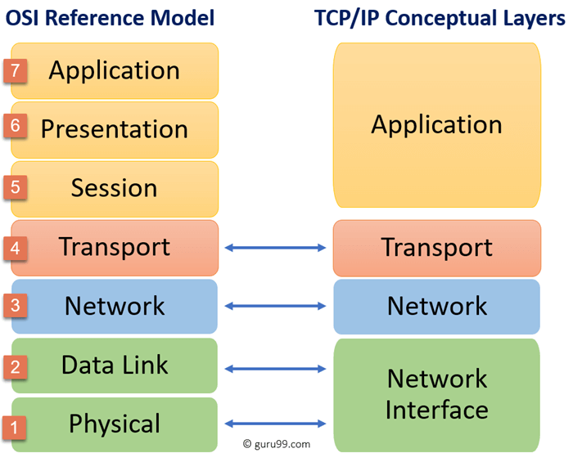
TCP/IP

Slide 17
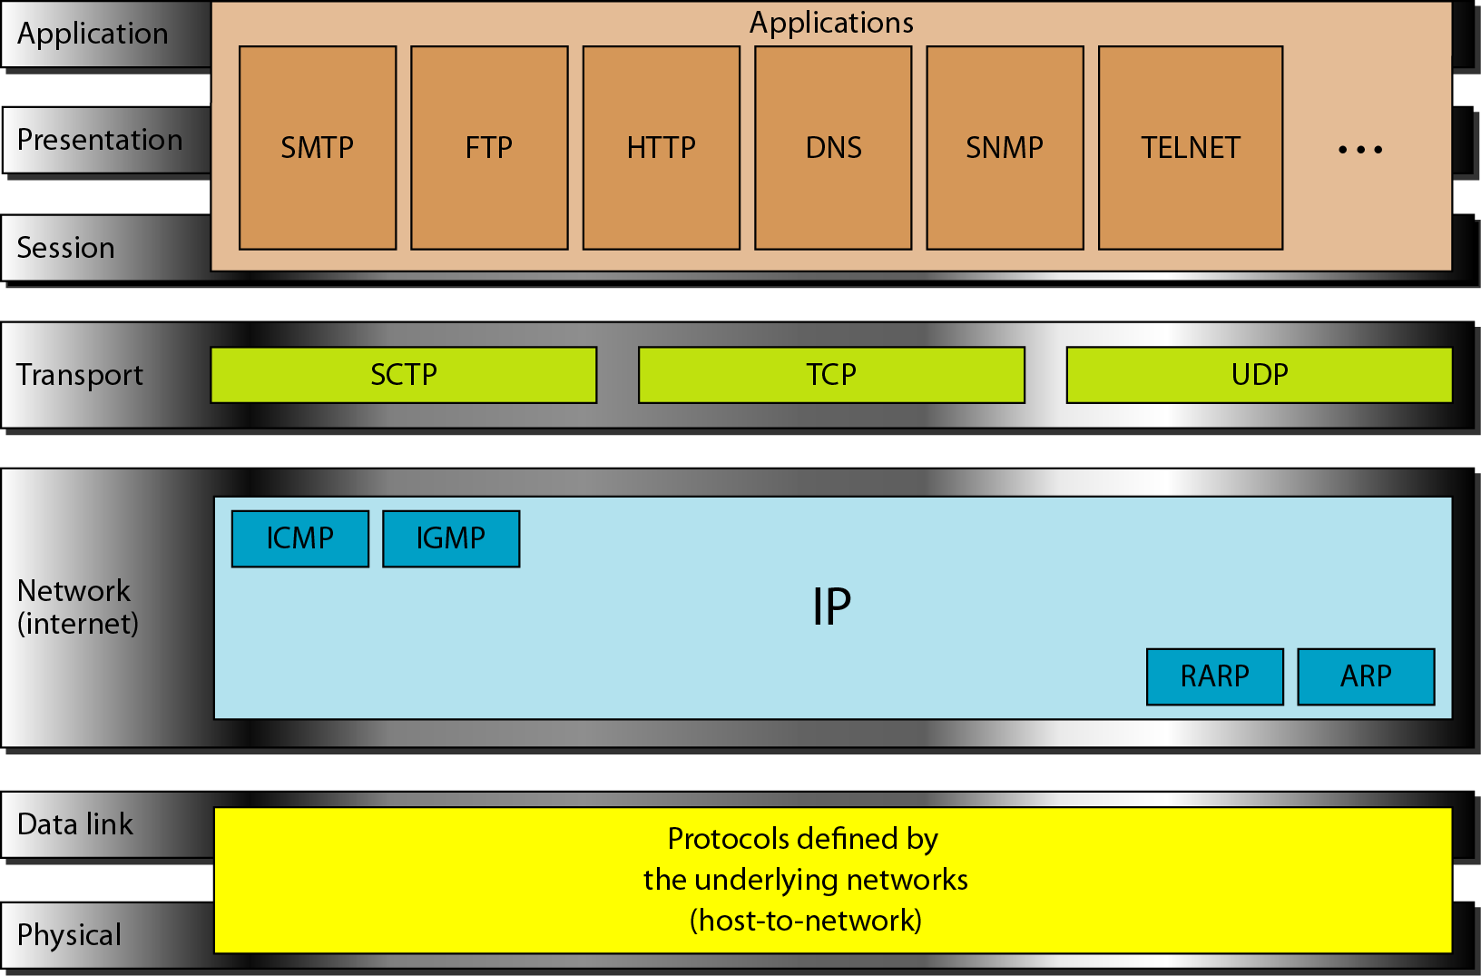
Protocols

Slide 18
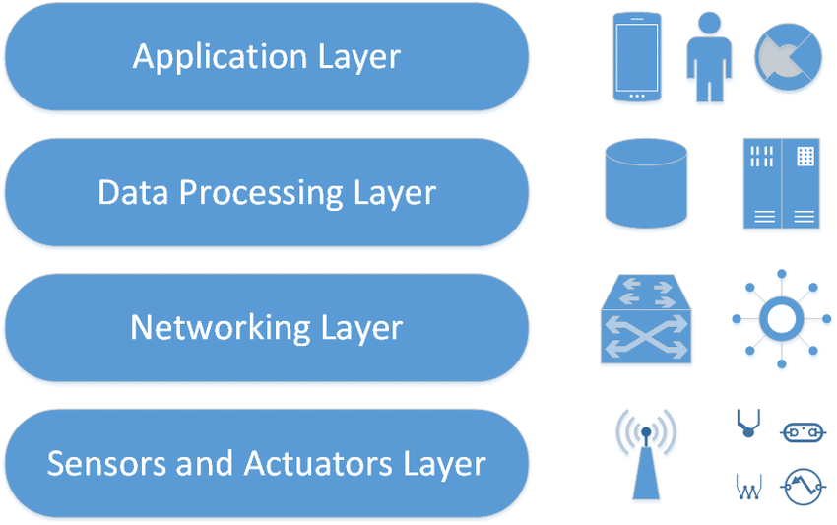
IoT Architecture - Stack
Business Layer
Application Layer
Processing Layer
Transport Layer
Perception Layer
Notes:
Application Layer
The application layer defines all applications in which IoT has deployed. It is the interface between the end IoT devices and the network. IoT Applications such as smart homes, smart health, smart cities, etc. It has the authority to provide services to the applications. The services may be different for each application because of services based on the information collected by sensors.
It is applied through a dedicated application at the device end. Such as for a computer, the application layer is applied by the browser. It is the browser that executes application layer protocols like HTTP, HTTPS, SMTP, and FTP. There are many concerns in the application layer out of which security is the key issue.
Data Processing Layer
In three-layer architecture, the data were directly sent to the network layer. Due to sending data directly the chances of getting damages increase. In four-layer architecture, data is sent to this layer that is obtained from a perception layer. Data Processing Layer has two responsibilities it confirms that data is forwarded by the authentic users and prevented from threats.
Authentication is the most commonly used method to verify the users and the data. It is applied by using pre-shared, keys and passwords to the concerned user. The second responsibility of the layer is to send information to the network layer. The medium through which data is transferred from the Data Processing Layer to the network layer can be wireless and wire-based.
Network Layer
This layer is also known as a transmission layer. It acts like a bridge that carries and transmits data gathered from physical objects through sensors. The medium can be wireless or wire-based. It also connects the network devices and networks to each other. Hence, it is extremely sensitive to attacks from the attackers. It has important security issues regarding integrity and authentication of data that is being transmitted to the network.
Perception layer/Sensor layer
The sensor layer has the responsibility to recognize things and gather the data from them. There are many types of sensors connected to the objects to gather information such as RFID, sensors and 2-D barcode. The sensors are selected as per the requirement of applications. The data that is collected by these sensors can be about location, changes in the air, environment, etc. However, they are the main aim of attackers who wish to use them to replace the sensor with their own.

Slide 19
Physical Design of IoT
Things in IoT – refers to devices which have unique identities and can perform remote sensing, actuating and monitoring capabilities.
IoT devices can:
Exchange data with other connected devices and applications (directly or indirectly), or
Collect data from other devices and process the data locally or
Send the data to centralized servers or cloud-based application back-ends for processing the data, or
Perform some tasks locally and other tasks within the IoT infrastructure, based on temporal and space constraints

Slide 20
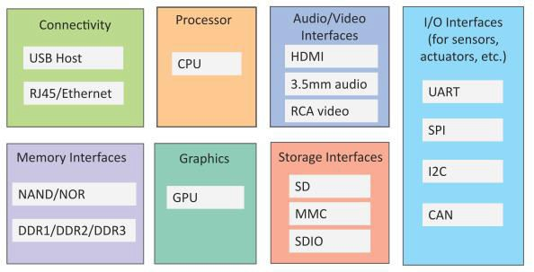
Generic block diagram of an IoT Device
An IoT device may consist of several interfaces for connections to other devices, both wired and wireless.
I/O interfaces for sensors
Interfaces for Internet connectivity
Memory and storage interfaces
Audio/video interfaces.
Reference : Bahga & Madisetti, © 2015 Book website: http://www.internet-of-things-book.com
Notes:
An IoT device may consist of several interfaces connections to other devices, both wired and wireless. These include I)IoT interfaces for sensors II) interfaces for internet connectivity III) memory and storage interfaces IV) audio video interfaces. An IoT Device can collect various types of data from the the onboard or attached sensors, such as temperature e , humidity, light intensity.
IoT devices can also be varied types, for instance, wearable sensors, smart watches, LED light automobiles and industrial machines. Almost all I would advise generate data in Some form or the other which when processed by Data Analytics systems leads to Useful information to guide further actions locally or remotely.

Slide 21
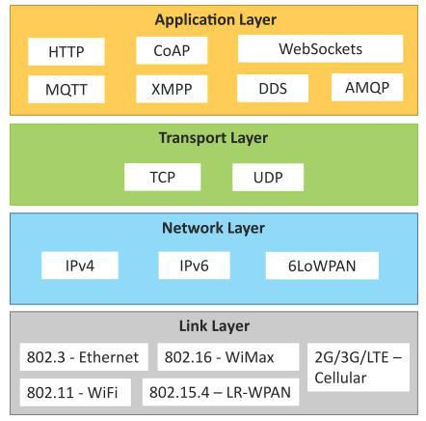
IoT Protocols
Link Layer
802.3 – Ethernet
• 802.11 – WiFi
• 802.16 – WiMax
• 802.15.4 – LR-WPAN
• 2G/3G/4G
Network/Internet Layer
IPv4
IPv6
6LoWPAN
Transport Layer
TCP
UDP
Application Layer
HTTP
CoAP
WebSocket
MQTT
XMPP
DDS
AMQP
Reference : Bahga & Madisetti, © 2015 Book website: http://www.internet-of-things-book.com

Slide 22
Link Layer
Link Layer protocols determine how the data is physically sent over the networks physical layer or medium(example copper wire, electrical cable, or radio wave).
The Scope of The Link Layer is the Last Local Network connections to which host is attached.
Host on the same link exchange data packets over the link layer using the link layer protocol.
Link layer determines how the packets are coded and signaled by the hardware device over the medium to which the host is attached.

Slide 23
Link Layer Protocols
802.3 Ethernet
802.1- WI-FI
802.16 wiMAX
Sr.No | Standard | Shared medium
1 | 802.3 | Coaxial Cable…10BASE5
2 | 802.3.i | Copper Twisted pair …..10BASE-T
3 | 802.3.j | Fiber Optic……10BASE-F
4 | 802.3.ae | Fiber…..10Gbits/s
Sr.No | Standard | Operates in
1 | 802.11a | 5 GHz band
2 | 802.11b and 802.11g | 2.4GHz band
3 | 802.11.n | 2.4/5 GHz bands
4 | 802.11.ac | 5GHz band
5 | 802.11.ad | 60Hz band
Sr.No | Standard | Data Rate
1 | 802.16m | 100Mb/s for mobile stations 1Gb/s for fixed stations
Collection of Wireless Broadband standards
Data Rates from 1.5Mb/s to 1 Gb/s
Data Rates are provided from 10Gbit/s to 40Gb/s and higher
Data Rates from 1Mb/s to 6.75 Gb/s

Slide 24
Link Layer Protocols
802.15.4 LR-WPAN
2G / 3G / 4G mobile communications
Collection of standards for low-rate wireless personal area networks
Basis for high level communication protocols such as Zigbee
Data Rates from 40Kb/s to 250Kb/s
Provide low-cost and low-speed communication for power constrained devices
Sr.No | Standard | Operates in
1 | 2G | GSM-CDMA
2 | 3G | UMTS and CDMA 2000
3 | 4G | LTE
Data Rates from 9.6Kb/s (for 2G) to up to 100Mb/s (for 4G)

Slide 25
Network Layer
The network layer are responsible for sending of IP datagrams from the source network to the destination network.
This layer Performs the host addressing and packet routing.
The datagrams contains a source and destination address which are used to route them from the source to the destination across multiple networks.
Host Identification is done using the hierarchy IP addressing schemes such as ipv4 or IPv6.

Slide 26
Network Layer Protocols
IPV4
IPv6
6LoWPAN
most deployed internet protocol that is used to identify the device is on a network
It uses 32 bit addresses scheme that allows total of 2^32 address.
As more and more devices got connected to the internet. The Ipv4 has succeeded by IPv6.
newest versions of internet protocol
successor to IPv4.
IPv6 uses 128 bit address schemes
IPv6 over low power wireless personal area networks brings IP protocol to the low power device which have limited processing capability
it operate in the 2.4 GHz frequency range and provide the data transfer rate up to 250 kb/s

Slide 27
Transport Layer
The Transport layer protocols provides end-to-end message transfer capability independent of the underlying network.
The message transfer capability can be set up on connections, either using handshake or without handshake acknowledgements.
Provides functions such as error control , segmentation, flow control and congestion control.

Slide 28

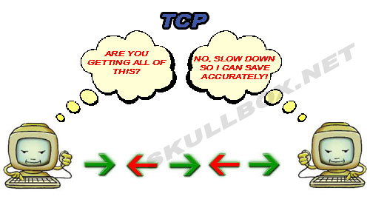
Transport Layer Protocols - TCP
Transmission Control Protocol
Connection Oriented
Ensures Reliable transmission
Provides Error Detection Capability to ensure no
duplicity of packets and retransmit lost packets
Flow Control capability to ensure the sending data
rate is not too high for the receiver process
Congestion control capability helps in avoiding
congestion which leads to degradation of n/w
performance

Slide 29

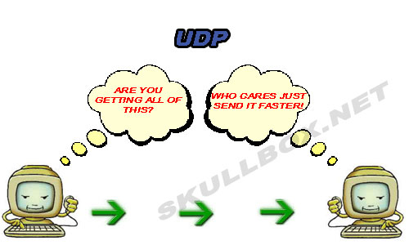
Transport Layer Protocols - UDP
User Datagram Protocol
Connectionless
Does not ensures Reliable transmission
Does not do connection before transmitting
Does not provide proper ordering of messages
Transaction oriented and stateless

Slide 30
Application Layer
Application layer protocol define how the application interfaces with the lower layer protocols to send the data over the network.
Data are typically in files, is encoded by the application layer protocol and encapsulated in the transport layer protocol .
Application layer protocol enable process-to-process connection using ports.

Slide 31

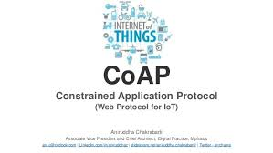
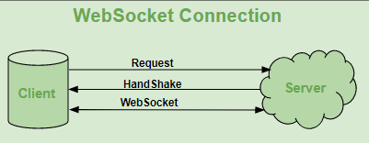
Application layer Protocols
Http
CoAP
Websocket
Hypertext transfer protocol is the application layer protocol that forms the foundations of world wide web
The protocol follows a request-response model where are client sends request to server using the http, commands.
Constrained application protocol is an application layer protocol for machine to machine application
M2M meant for constrained environment with constrained devices and constrained networks.
Websocket is based on TCP and Allows streams of messages to be sent back and forth between the client and server
The client can be a browser, a mobile application and IoT device

Slide 32
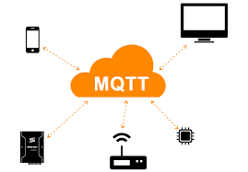
Application layer Protocols
MQTT
XMPP
DDS
Message Queue Telemetry Transport it is a lightweight message protocol based on public -subscribe model
MQTT uses a client server Architecture by the clients such as an IoT device connect to the server
Extensible Messaging and Presence Protocol it is a protocol for real-time communication and streaming XML data between network entities
XMPP powers wide range of applications including messaging, presence, data syndication, gaming multiparty chat and voice / voice calls
Data Distribution service is a data-centric middleware standard for device-to-device or machine-to-machine communication.
Publish subscribe model where publishers create topics to which subscribers can use.
Provides Quality-of-service control and configurable reliability.

Slide 33
Thank you!

